Slide 1

TYPES OF MATERIALS
FLOW OF HEAT

Slide 2
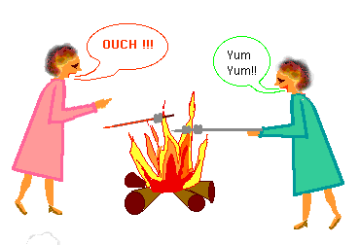
Why does the lady in the pink dress drop her roasting stick before the lady in the green dress?

Slide 3
Conductors and Insulators
Some materials conduct heat better than others.
Materials that transfer heat well are called conductors.
Metals are usually good conductors.
Wood, paper and plastic are not.
Materials that stop the transfer of heat are called insulators (styrofoam, wool, fiberglass).

Slide 4
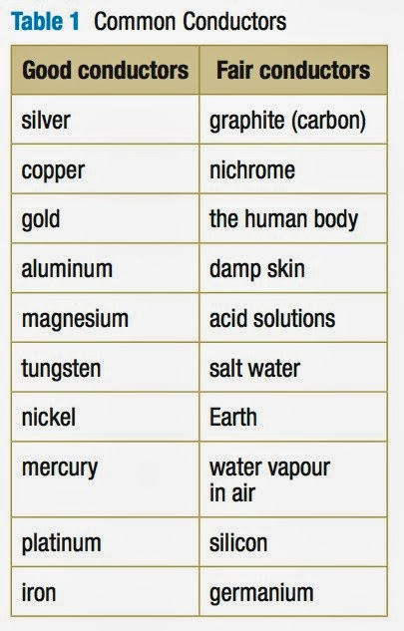
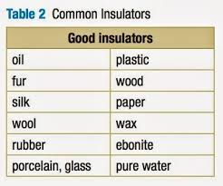
Conductors and Insulators

Slide 5

Why does metal feel colder than wood, if they are both at the same temperature?
Metal is a conductor, wood is an insulator. Metal conducts the heat away from your hands. Wood does not conduct the heat away from your hands as well as the metal, so the wood feels warmer than the metal.

